Slide 1
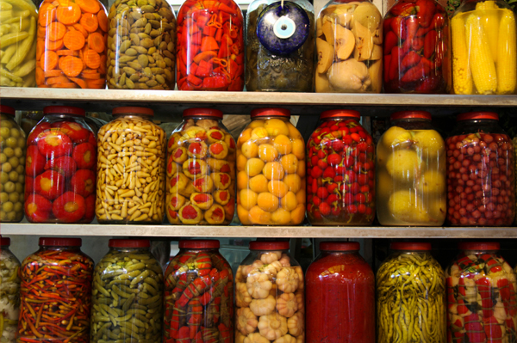
The Fermentation of Food
Chapter 22

Slide 2
Objectives
Terms
Describe the history of fermentation
Explain why food is fermented
Compare respiration in human metabolism to anaerobic respiration in food science
Explain what causes fermentation
Summarize information on bacterial fermentation works in bread making
Explain the value of molds and enzymes in food production
Describe how various fermented beverages are made
Aerobic
Anaerobic
Anaerobic Respiration
Brine
Brine Pickling
Cell Respiration
Fresh-pack Pickling
Indigenous
Microbes
Microorganisms
Pasteurization

Slide 3
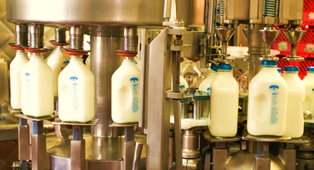
Fermentation in History
Fermentation started taking place before recorded history
Nomads noticed that milk would change to solid cheese or semisolid yogurt under certain conditions
For centuries people have made alcoholic beverages by using yeast to ferment fruit juices
In the 1850’s wine was spoiling so Louis Pasteur realized that certain bacteria in the wine were also fermenting and spoiling the wine.
Pasteur suggested heat treating the wine to kill bacteria, the process of pasteurization is still used today, most commonly for milk

Slide 4
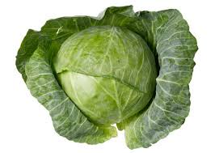
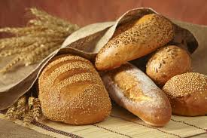
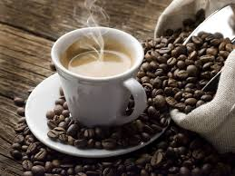
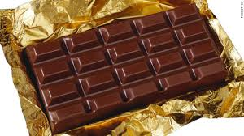
Benefits of Fermentation
Extends the time food can be stored without spoiling
Some foods are more enjoyable to eat when fermented
Example – easier to chew
Makes some foods more usable
Examples – chocolate or coffee

Slide 5
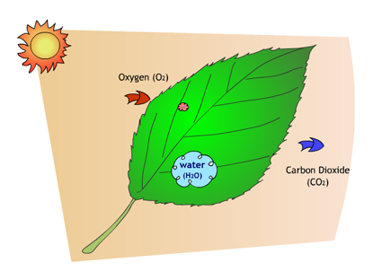
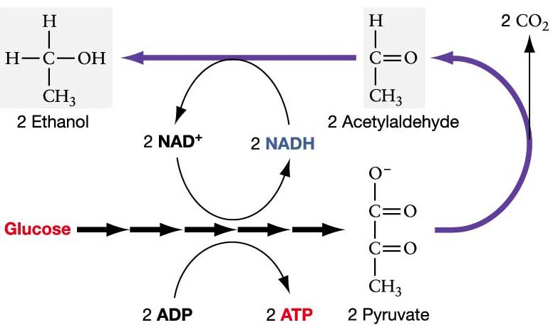
Human respiration vs. Anaerobic Respiration
- In human respiration uses oxygen, but in anaerobic respiration uses electron acceptors instead of oxygen. - Primary goals are the same.

Slide 6
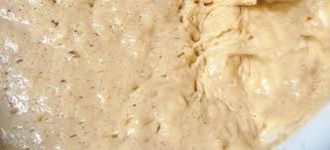
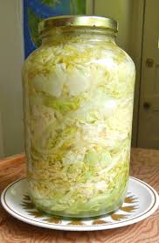
The Fermentation Process
Cell Respiration- process releases energy from glucose when the glucose molecules in the cell is broken down
Aerobic- reaction taken place in the presence of air or oxygen
Anaerobic- reaction occurring in the absence of oxygen
Anaerobic Respiration- respiration that occurs
without oxygen
Microorganisms or Microbes are single cells of microscopic sizes that cannot be seen by the human eye

Slide 7
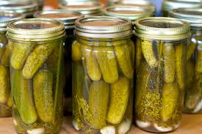
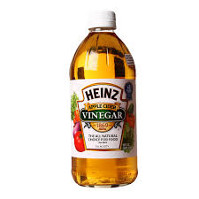
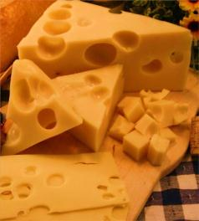
Bacterial Fermentation
Lactic–acid bacteria – Used to produce pickles and sauerkraut
Acetic–acid bacteria – use fermentation in the vinegar making process
Carbon–dioxide bacteria – used to make Swiss cheeses
Proteolytic bacteria – break down protein in cocoa and chocolate for candy and beverages

Slide 8
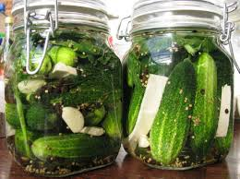
Sources of Bacteria
Indigenous- found naturally in a particular environment such as cabbage and cucumbers
Lactic-Acid- used in yogurt, sour cream, cottage cheese, cheddar cheese, dill pickles, olives, sauerkraut and vanilla

Slide 9
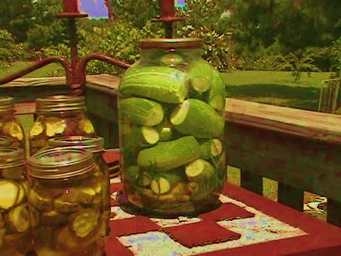
Pickles
Brine- a water-and-salt mixture that contains large amounts of salt
Brine Pickling- the vegetable remains in the brine for several weeks until a low pH is reached
Fresh-pack Pickling- the vegetable is in the brine overnight

Slide 10
Sauerkraut
Bacteria growth promoted – soil-borne, lactic-acid on the surface of cabbage
Washing before shredding helps the bacteria grow
Salt helps produce lactic acid
pH lowers during fermentation
How to make sauerkraut the easy way!(4:09)
http://www.youtube.com/watch?v=lpkQbhq4bYQ

Slide 11
Yeast Fermentation
Fermentation (5:38)
http://www.youtube.com/watch?v=4SosPuWAg7g

Slide 12
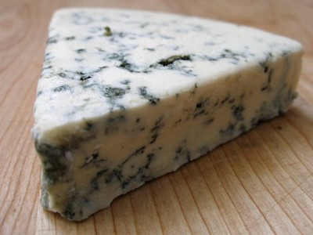
Enzymes and Molds
Enzymes are protein molecules that are the catalysts to all chemical reactions.
Enzymes are important because they help break down foods and absorb nutrients we need.
Some molds are safe to eat and some are not.
Good molds are used in cheeses and in yogurt and are safe to be manufactured and eaten.
How to Make Greek Yogurt at Home (9:39)
http://www.youtube.com/watch?v=5ZZAUqFqAnY

Slide 13
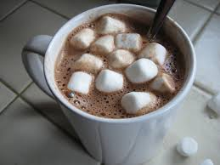
Fermentation of Beverages
Fermented Lemonade (6:16)
http://www.youtube.com/watch?v=46nKpErTgZ8
Hot Cocoa (5:41)
http://www.youtube.com/watch?v=GXI5hd6pKds

